Slide 1




Credit Card Fraud Detection
TEAM V
Aveline Mariya Shaji, Kyuri Kim, Satya Bharath Reddy Duvvi

Slide 2
INTRODUCTION

Slide 3
Purpose
To use different methods to handle “Unbalanced Data”.
Implement different ML Algorithms and identify the best model for predicting Credit Card Fraud Detection.

Slide 4
SMART Questions
Which ML model performs best in predictive analysis on credit card transaction dataset and detect the fraudulent transactions from the given dataset !?

Slide 5
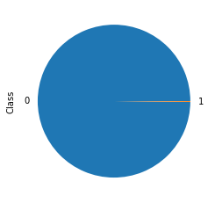
Data
September 2013 data by European cardholders
Unbalanced Data: 492 frauds out of 284,807 transactions (0.172%)
Contains only numerical input variables which are the result of a PCA transformation
Data Source: https://www.kaggle.com/mlg-ulb/creditcardfraud

Slide 6
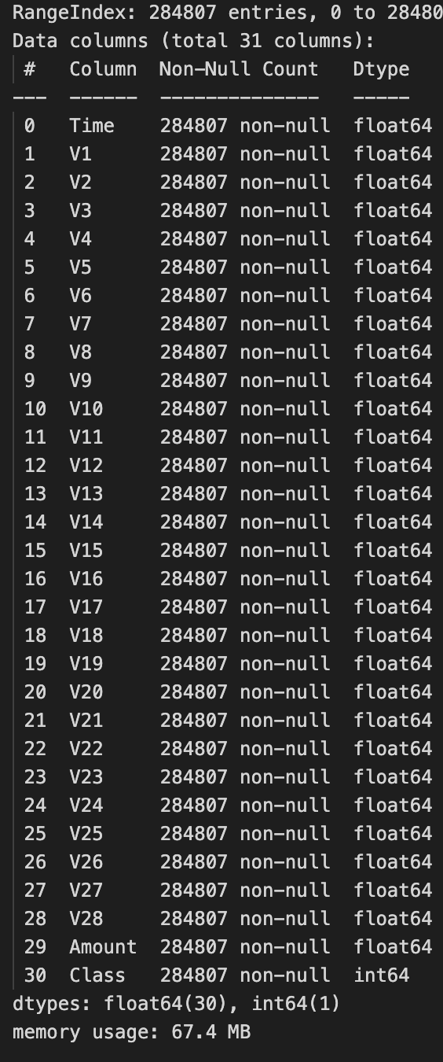
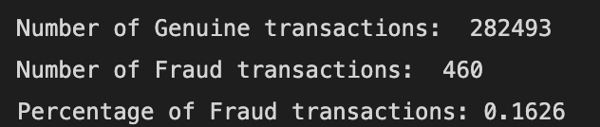
The Blue-Print
Import Data set
Removed missing Values
Checked and deleted Duplicates
Basic EDA
Implemented Balancing Techniques
Used ML Algorithms on final data

Slide 7
DATA VISUALIZATION

Slide 8
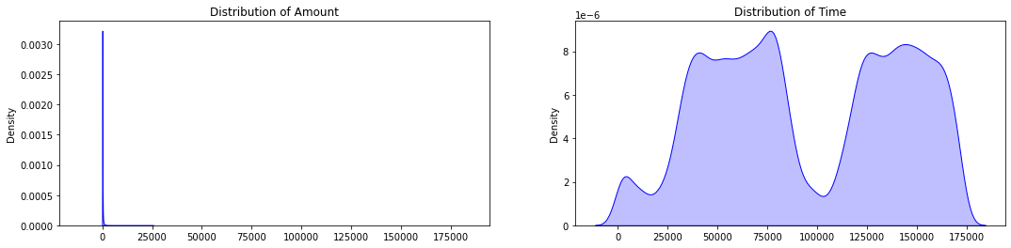
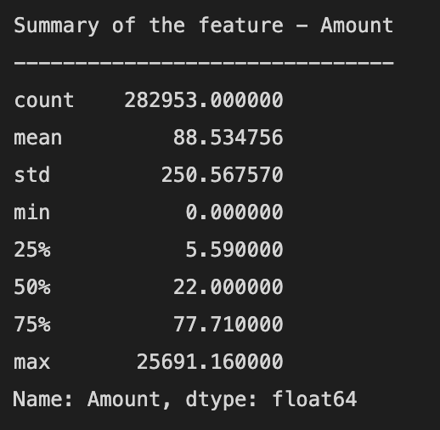
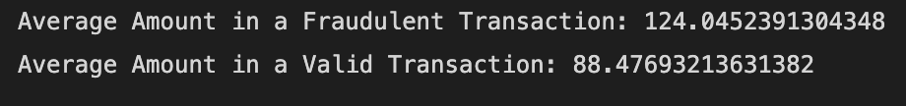
Distribution of Amount & Time

Slide 9
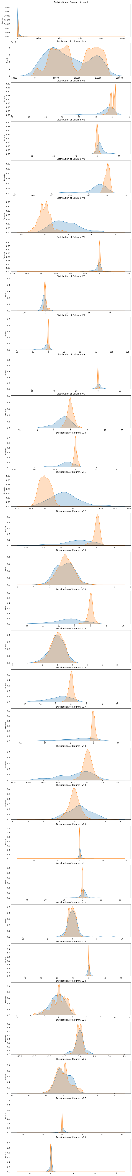

Slide 12
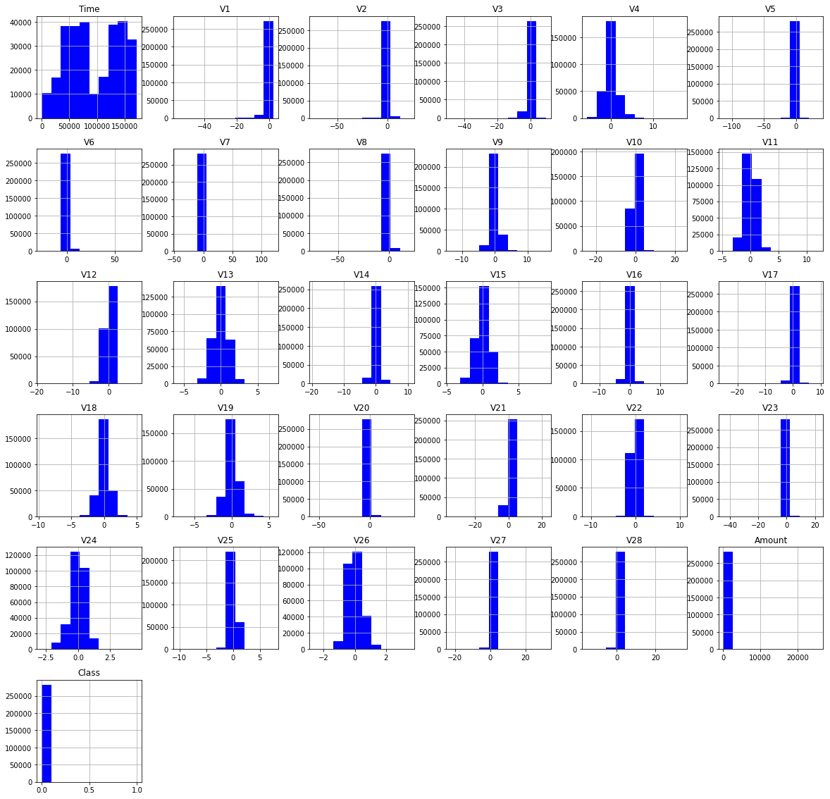
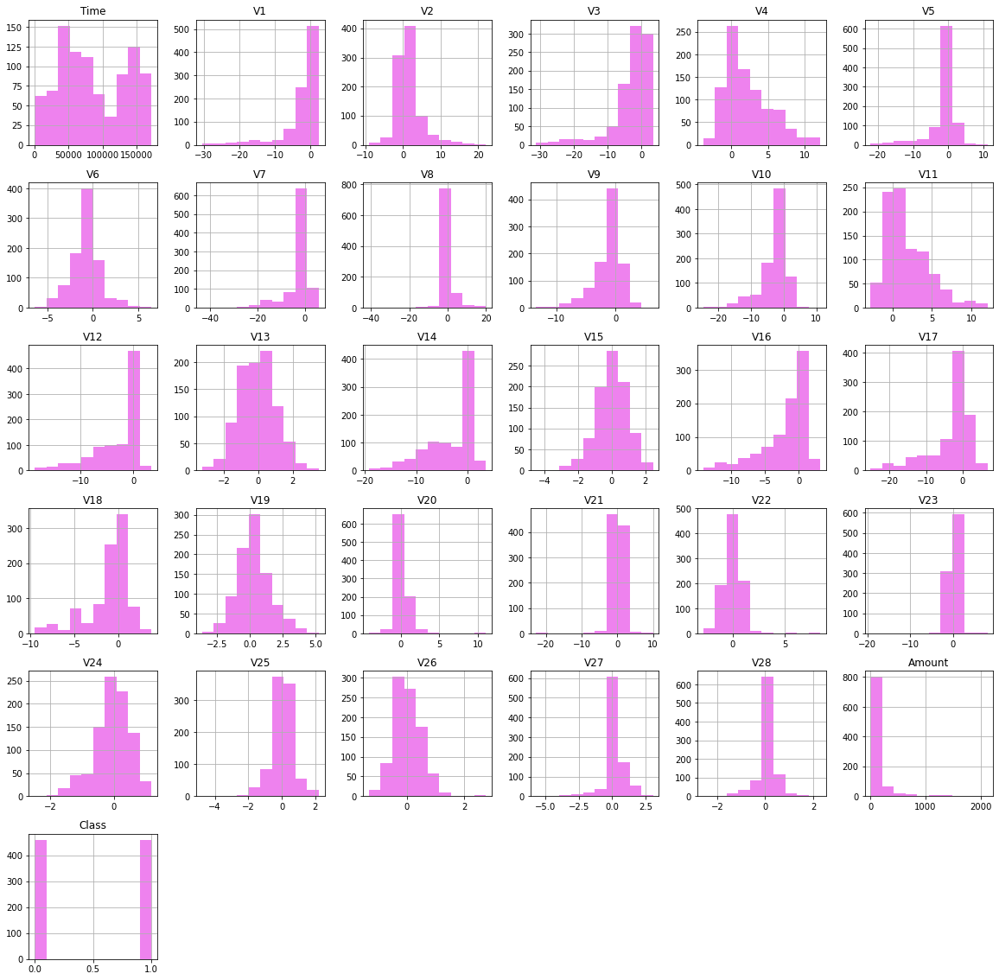
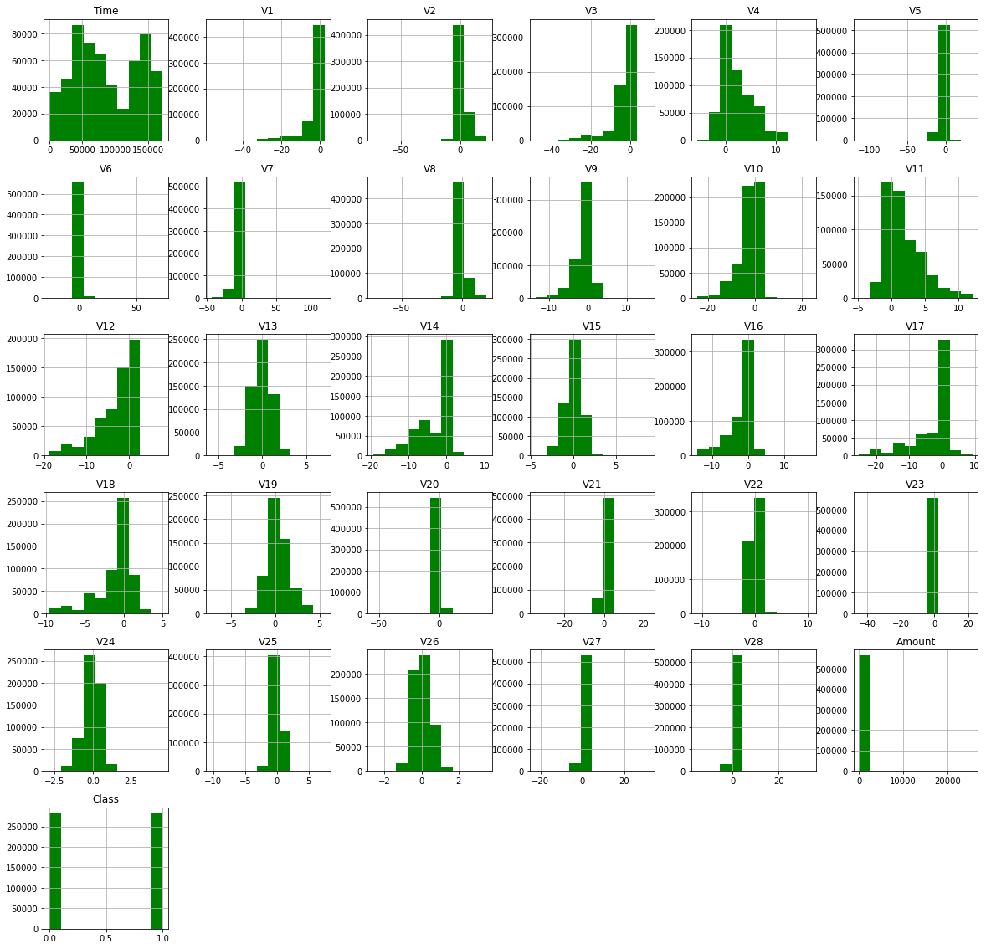
Unbalanced Data
Under Sampling
Over Sampling

Slide 13
ML Models in Unbalanced Data

Slide 14
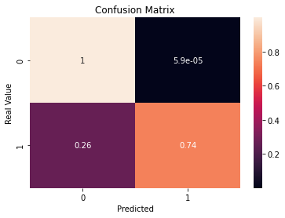
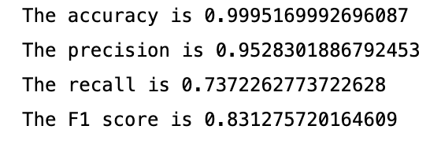
Random Forest Classifier

Slide 15
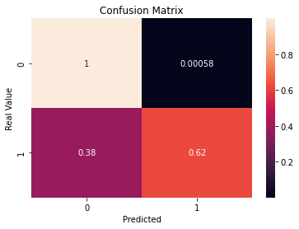
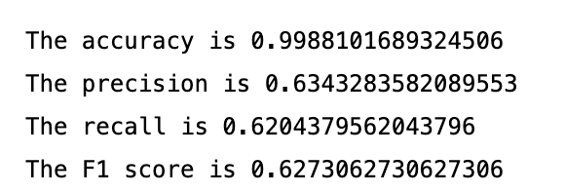
Logistic Regression

Slide 16
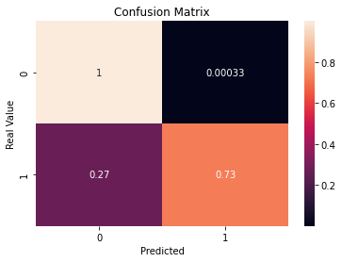
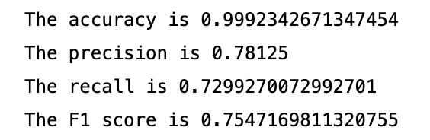
Decision Tree

Slide 17
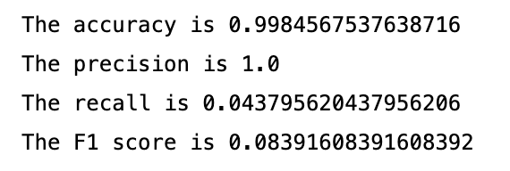
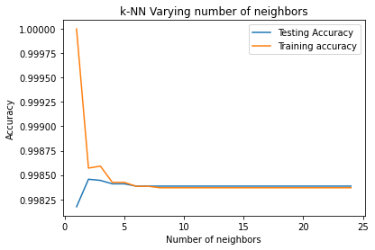
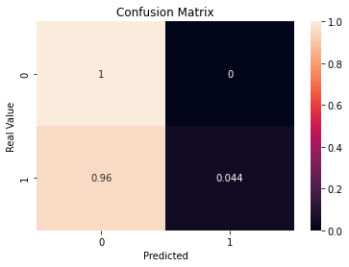
KNN Model

Slide 18
ML Models in Under-Sampling

Slide 19
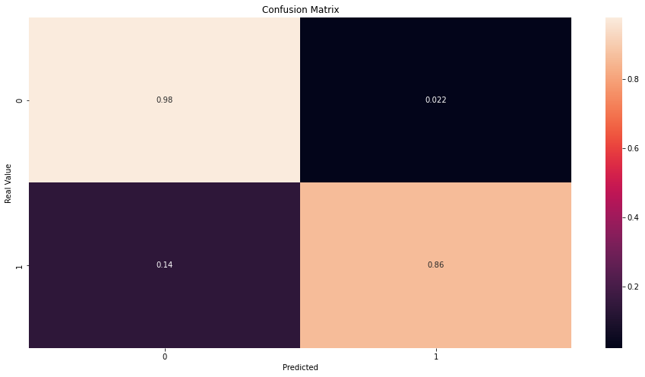
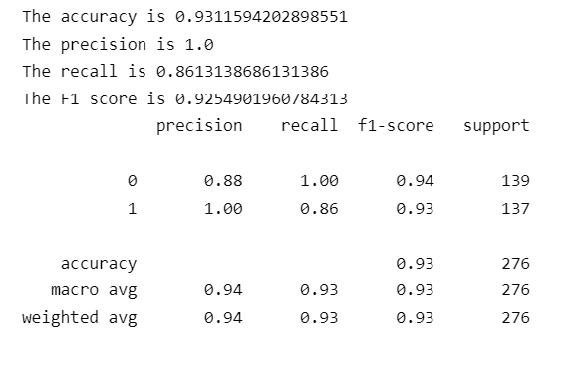
Random Forest Classifier

Slide 20
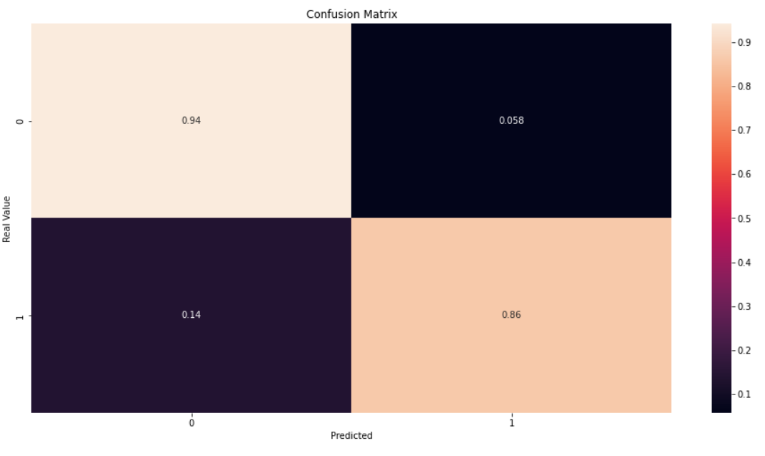
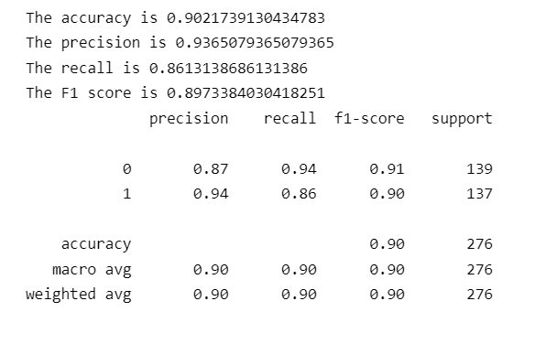
Logistic Regression

Slide 21
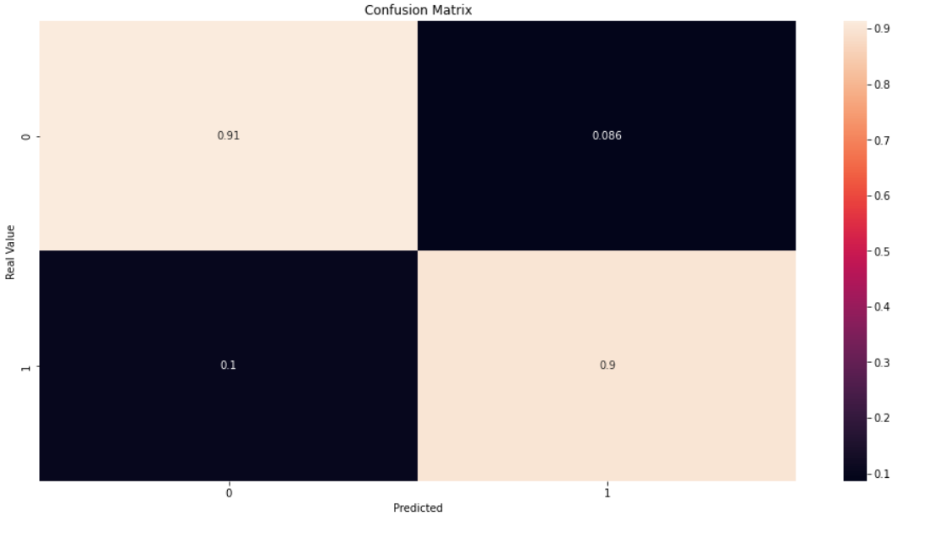
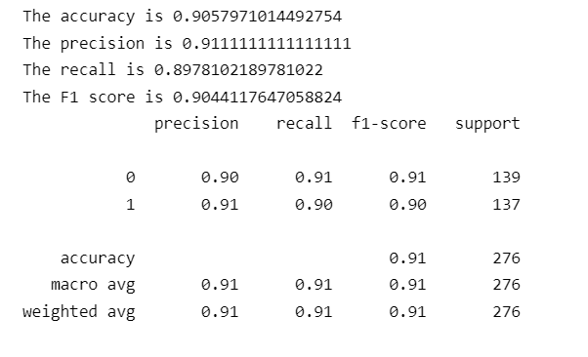
Decision Tree

Slide 22
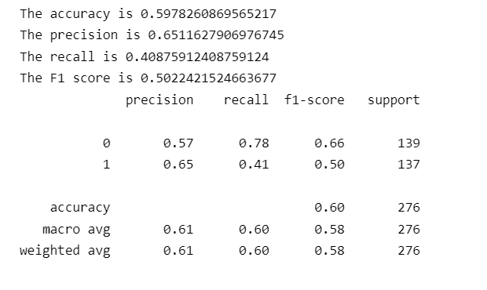
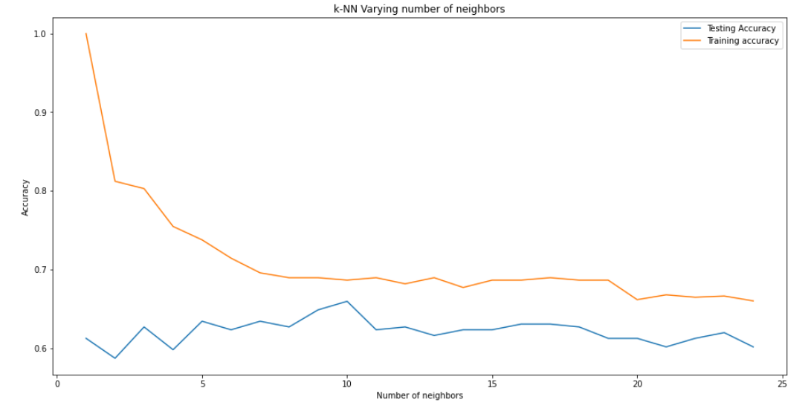
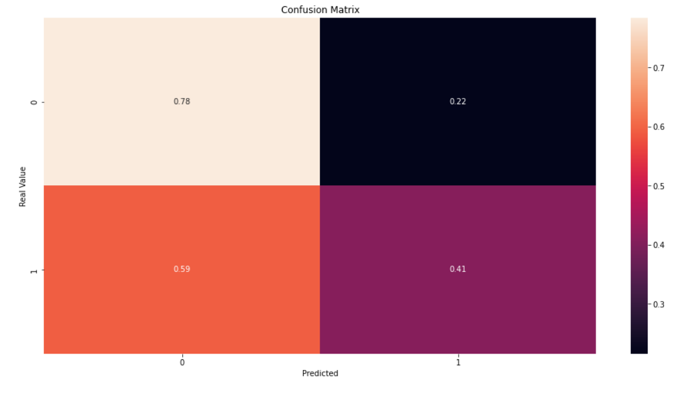
KNN Model

Slide 23
ML Models in Over-Sampling

Slide 24
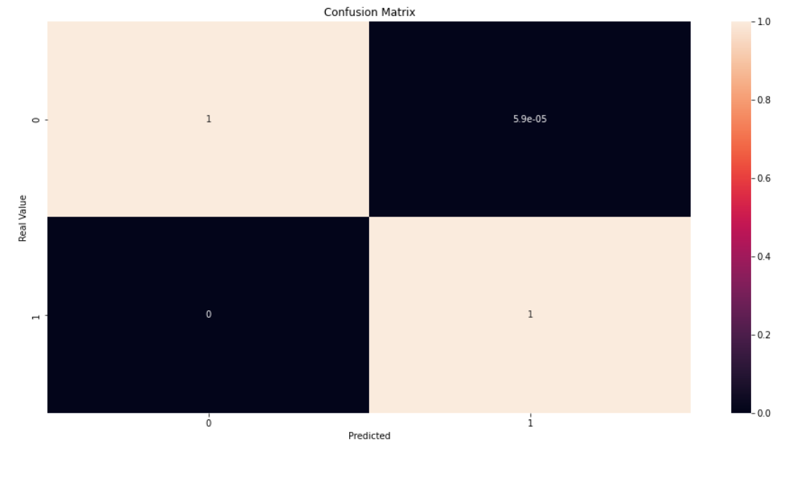
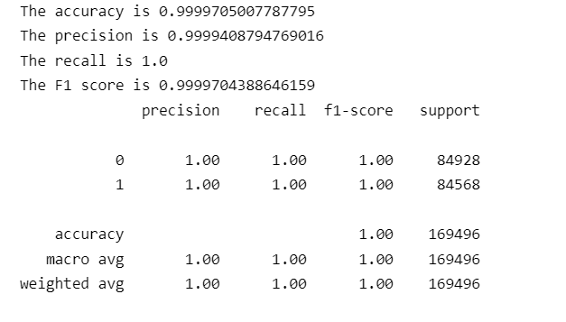
Random Forest Classifier

Slide 25
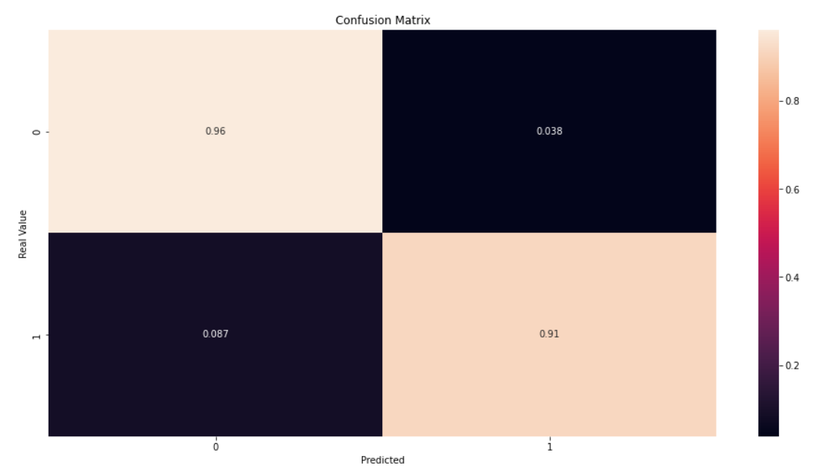
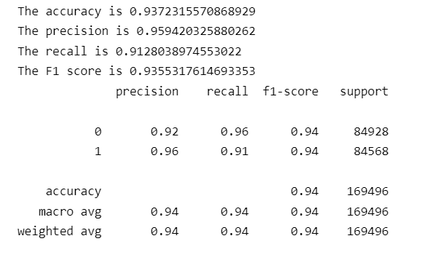
Logistic Regression

Slide 26
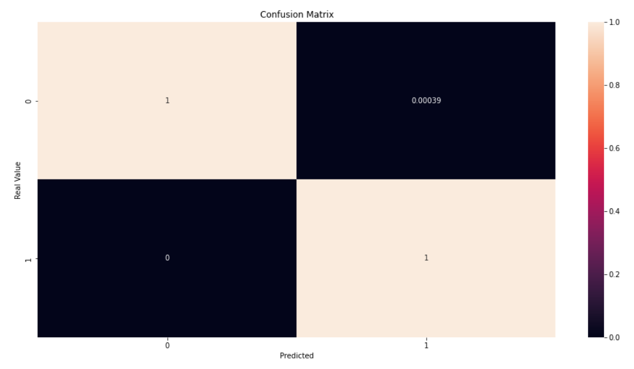
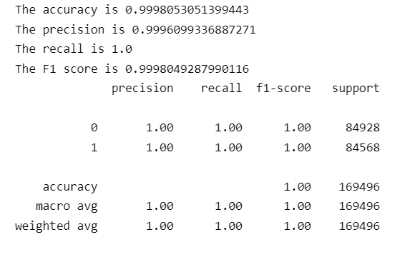
Decision Tree

Slide 27
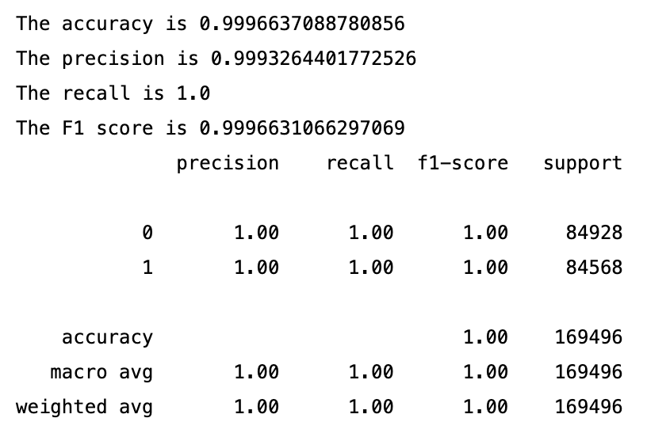
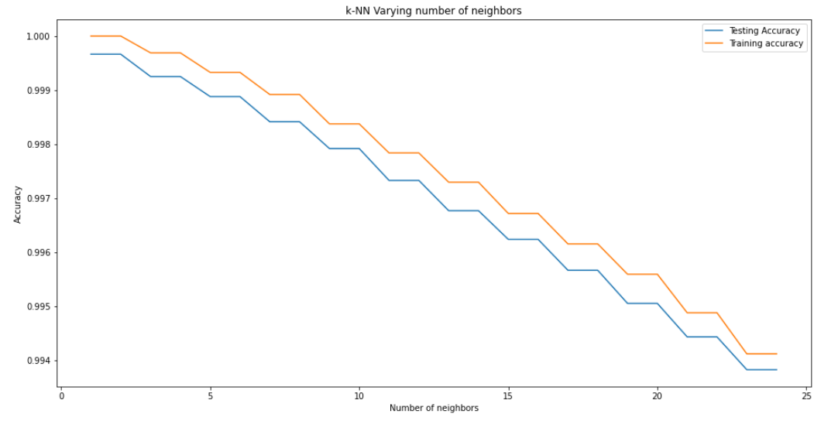
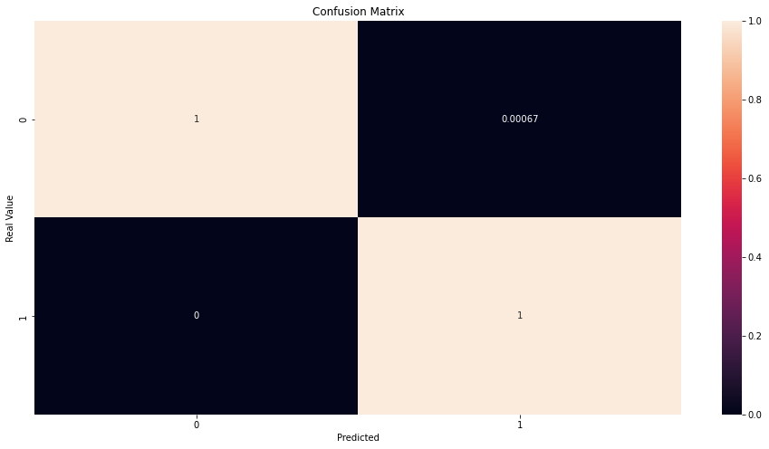
KNN Model

Slide 28
CONCLUSION

Slide 29
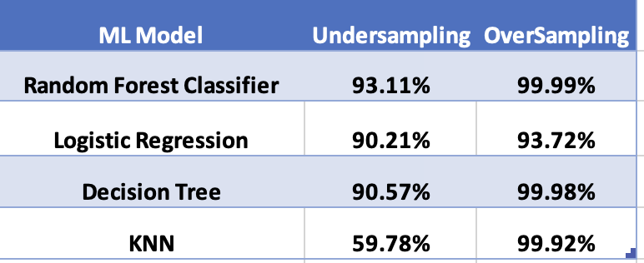
Oversampling gives better accuracy models
RFC is the best model

